Slide 1


Boosting Loan Acceptance Rates for Galaxy Bank with Predictive Modelling

Slide 2



TITAN ANALYTICS
VISION AND MISSION
Vision
Transforming marketing with machine learning
Mission
To help businesses achieve their marketing goals through the power of data and machine learning.

Slide 3


TITAN ANALYTICS
MEET THE PRESENTER
Umar Kabir
Data Scientist

Slide 4

TITAN ANALYTICS
TABLE OF CONTENTS
01
Introduction
06
Model Evaluation/Selection
02
Problem Statement
07
Business Value
Exploratory Data Analysis
03
08
Model Deployment
04
Feature Engineering
09
Conclusion
Modelling
05

Slide 5

TITAN ANALYTICS
INTRODUCTION
Aim: Increase loan conversion rates
Target: Potential deposit customers
Objective: Identify likely loan acceptors
Bank success: Upselling to deposit clients

Slide 6

TITAN ANALYTICS
PROBLEM STATEMENT
Converting deposit customers to loan customers
Not all offered loans accepted
Loan acceptance rate just over 9%
Poor targeted marketing

Slide 7
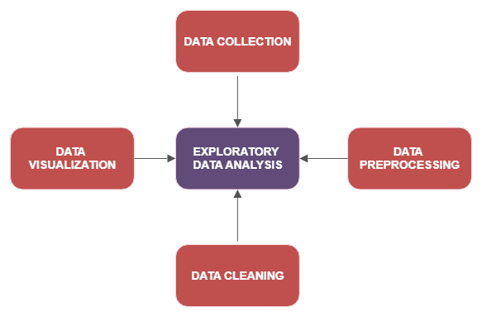
TITAN ANALYTICS
EXPLORATORY DATA ANALYSIS
Discover patterns
Spot anomalies
Check assumptions.

Slide 8
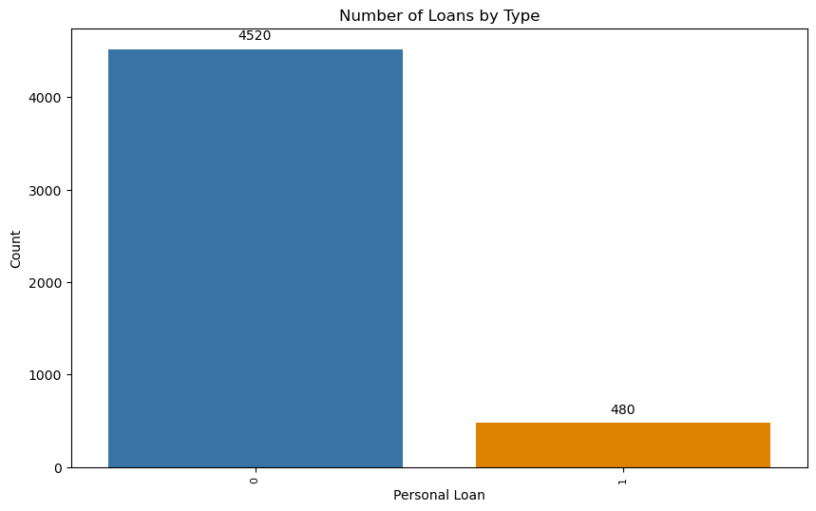
DISTRIBUTION OF PERSONAL LOAN
NO
YES

Slide 9
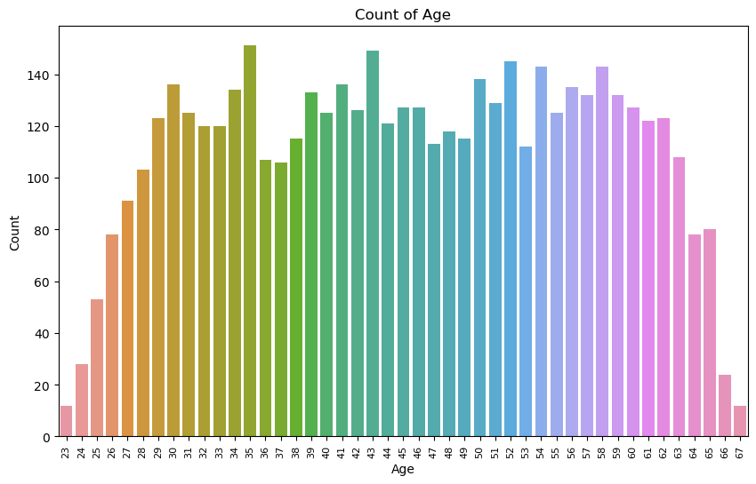
AGE DISTRIBUTION OF CUSTOMERS

Slide 10
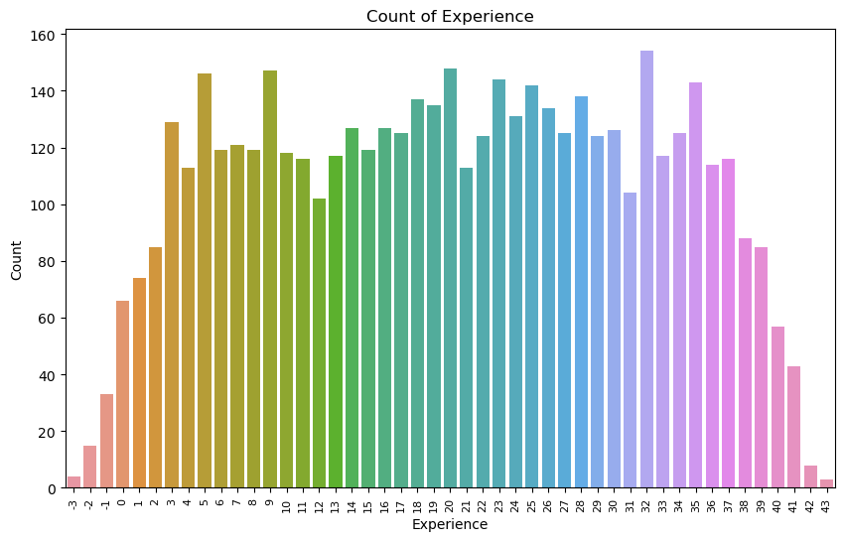
DISTRIBUTION OF EXPERIENCE

Slide 11
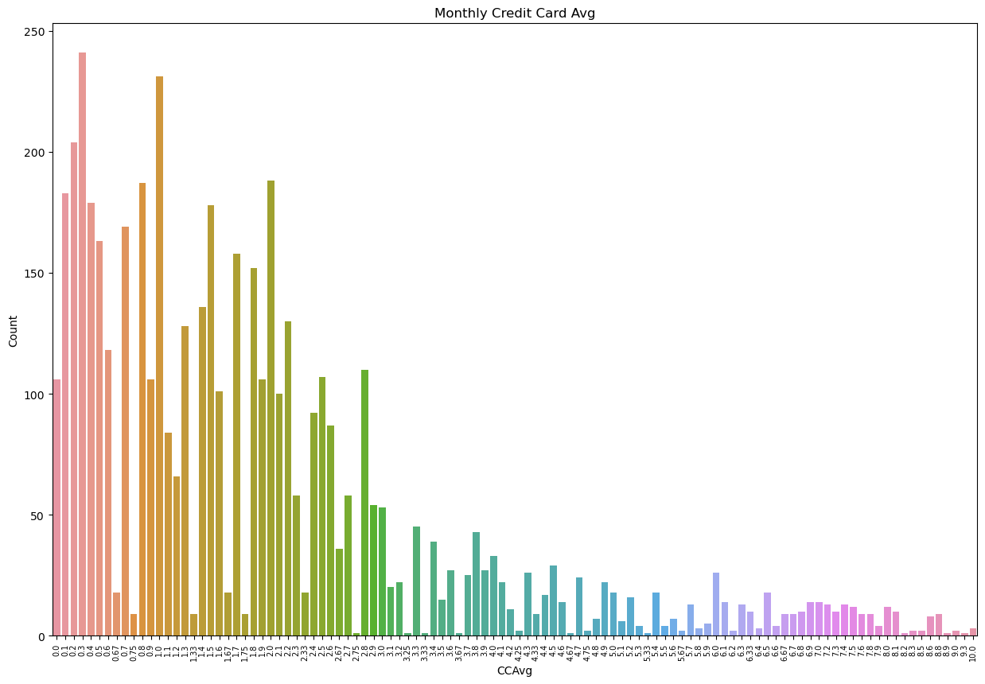
DISTRIBUTION OF CREDIT CARD AVERAGE

Slide 12
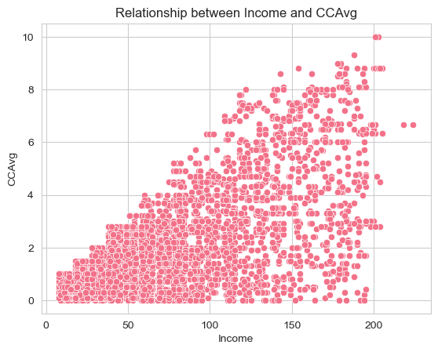
INCOME AND CCAVG RELATIONSHIP

Slide 13
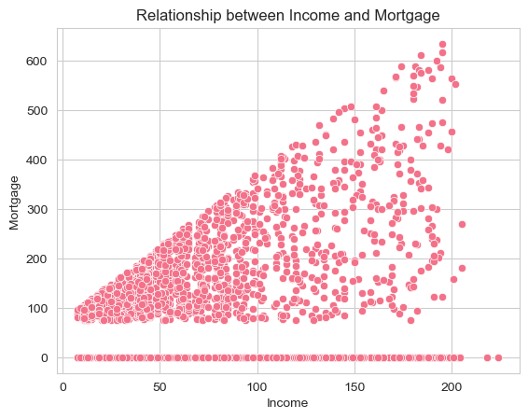
RELATIONSHIP BETWEEN INCOME AND MORTGAGE

Slide 14

TITAN ANALYTICS
DATA CLEANING

Slide 15
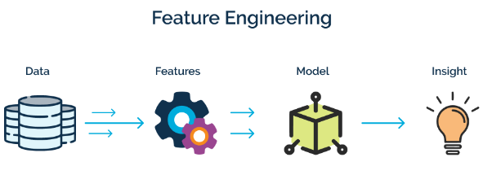
TITAN ANALYTICS
FEATURE ENGINEERING

Slide 16

MODELLING
TITAN ANALYTICS

Slide 17
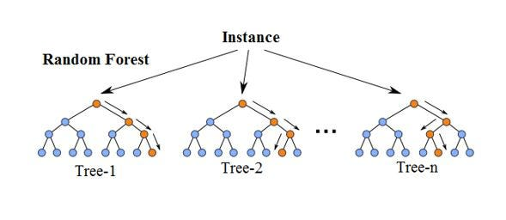
HOW MODELS WORK
RANDOM FOREST REGRESSOR

Slide 18
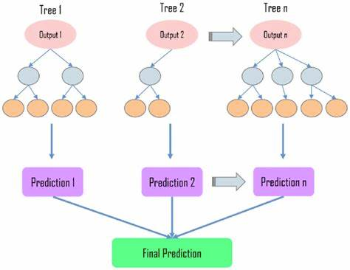
HOW MODELS WORK
DECISION TREE REGRESSOR

Slide 19
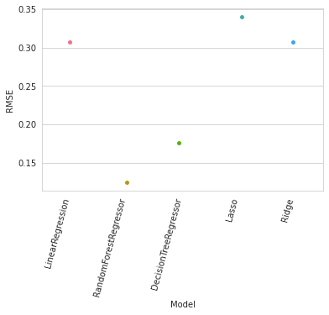
MODEL EVALUATION (RMSE)

Slide 20
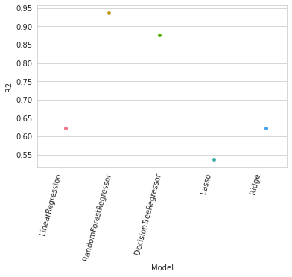
MODEL EVALUATION (R2)

Slide 21

TITAN ANALYTICS
BUSINESS VALUE
Increased loan acceptance rates
Improved marketing ROI
Increased revenue for the bank
Better customer targeting
Better understanding of customer behaviour
Improved market positioning
Increased market share
Enhanced data-driven culture

Slide 22

TITAN ANALYTICS
CONCLUSION
Machine learning models can help Galaxy Bank improve marketing conversion rates
High accuracy and generalizability of models suggest reliable predictions
Models can inform marketing strategy and improve decision making
Further exploration and validation of models on specific dataset recommended
Fine-tuning of models and incorporation into decision-making process suggested
Machine learning can help Galaxy Bank make data-driven decisions

Slide 23

TITAN ANALYTICS
Q & A

Slide 24

TITAN ANALYTICS
THANK YOU

